Slide 1
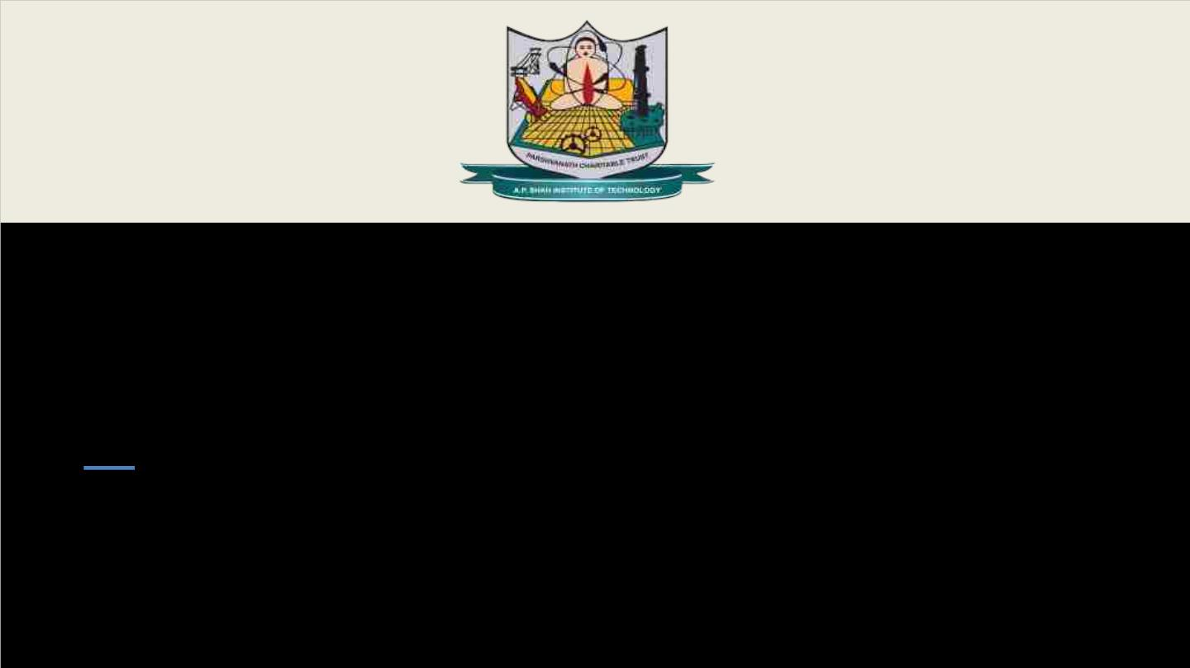
Department of Information Technology
NBA Accredited
A.P. Shah Institute of Technology
G.B.Road, Kasarvadavli, Thane (W), Mumbai-400615
UNIVERSITY OF MUMBAI
Academic Year 2023-2024

Slide 2

A Project Presentation on
Title of your project
Submitted in partial fulfillment of the degree of
Bachelor of Engineering(Sem-8)
in
INFORMATION TECHNOLOGY
By
Adarsh Singh(20104080)
Kanan Sananse(20104125)
Shruti Pinjarkar(20104016)
Under the Guidance of
Name of Guide

Slide 3

1.Project Conception and Initiation

Slide 4
1.1 Abstract
With over 70% of rural families in India reliant on agriculture for their livelihoods, its significance to the nation's economy cannot be overstated. Contributing about 17% to GDP, efficient farming practices are essential for sustained growth. However, lacking up-to-date information on soil quality and environmental factors often leads to decreased crop yields. To address these challenges, "Kisaan Dost“, a web-framework leveraging Machine Learning, IoT, and real-time data analytics, has being develope. This system will collect real-time data on soil quality and environmental parameters, process it for analysis and transmit to cloud and fog computing servers. By harnessing technologies like real-time data analytics and machine learning, valuable insights will be derive to optimize fertilizer application and crop growth. These insights empower informed decision-making, promoting environmentally friendly farming techniques and maximizing crop yields. By facilitating access to agricultural insights, "Kisaan Dost" aims to support optimal crop production and sustainable farming practices across India's agricultural landscape.

Slide 5

1.2 Objectives
To enable controlled optimization of crop growth and farm yields, parallelly maintaining Soil quality through generated insights regarding various in-field parameters using Data extraction modules and evaluation model.
To help farmers to grow plants under controlled climatic conditions for optimum produce using simple reflex based AI model utilized in automated irrigation system.
To get an insights of knowledge report regarding factors affecting plant growth, thus helping stakeholders take informed decisions of farming practices using Power BI.
To overcome the problem of over/under fertilization which is major concern for soil quality maintenance using Machine Learning Model.

Slide 6
1.3 Literature Review
Sr.No | Title | Key Findings | Year
[1] | Agro Farming Using Machine Learning | This paper discusses using machine learning to optimize crop production in agriculture by analyzing data on factors like environmental conditions, soil variability, and input levels. It addresses challenges such as water scarcity and pesticide usage, aiming to make critical farming decisions more effective and sustainable. The focus is on accurately estimating crop yields and selecting optimal parameters to maximize production while minimizing the negative impacts of natural calamities and chemical usage. | 2021

Slide 7
1.3 Literature Review
Paper No. | Title | Description | Year
[2] | IOT Based Smart Agriculture Monitoring System | This paper proposes an IoT-based Smart Agriculture Monitoring System to address challenges like water scarcity and low productivity. It monitors environmental conditions using sensors, processes data via a microcontroller, and transmits it wirelessly to a web application. The system enables farmers to remotely monitor crops, make informed decisions, and optimize growth, leading to increased yields and profitability. | 2019

Slide 8
1.3 Literature Review
Paper No. | Title | Description | Year
[3] | Smart Agriculture Monitoring and Control System Using IOT | This research explores IoT-enabled smart farming for improving agricultural decision-making by analyzing various crop growth parameters. It emphasizes leveraging IoT devices to modernize data collection and communication in agriculture. Factors like moisture, minerals, and light are examined to enhance crop growth and increase agricultural output. The goal is to empower farmers with data-driven insights for better decision-making and improved productivity. | 2022

Slide 9
1.3 Literature Review
Review Paper 3[3]: Smart Agriculture Monitoring and Control System Using IOT
Agriculture provides a wealth of data analysis parameters, resulting in increased crop yields. The use of IoT devices in smart farming aids in the modernization of information and communication. For better crop growth moisture, mineral, light and other factors can be assumed. This research looks into a few of these characteristics for data analysis with the goal of assisting users in making better agricultural decisions using IoT. The technique is intended to help farmers increase their agricultural output.

Slide 10
1.4 Problem Definition
Uncontrolled and largescale manual interference in various farming practices leading to declination in crop yield and production.
Due to lack of real-time knowledge and information of soil quality parameters/contents proportion in soil, like soil acidity level , percentage of Nitrogen Phosphorous, Potasium content in soil leading to lower the soil quality and thus causing under fertilization of various crops , this results in decline of optimum crop produce.

Slide 11
1.5 Scope
Can be used for the purpose of farming assistance.
Can be used to evaluate EDA analysis to study various constraint dependencies for optimal yield production .
Can be used for generation of insights for maintaining soil quality.
Can be used to generate visualization report of various environmental and soil content parameters responsible for crop growth.
Can be utilized for automation of irrigation system deployed on basis of simple-reflex based AI model.

Slide 12
1.6 Technology stack
FRONT-END:- HTML, CSS. JavaScript
BACKEND:- PHP(XAMPP), Python
DATABASE :- MySQL SERVER
SERVER:- XAMPP Server
FRAMEWORK(chatbot model) :- FLASK .
HARDWARE :- ESP32 microcontroller , Dht11 , Resistive soil moisture sensor, LDR sensor , Soil Acidity (pH) sensor , 4-channel relay module , actuator , circuit-building components.
ML model Framework :- AWS Sagemaker.
SOFTWARE :- Arduino IDE , Power BI , VS CODE EDITOR.
CLOUD Visualization dashboard :- ThingSpeak Server.

Slide 13
1.7 Benefits for environment & Society
Environmental sustainability: Optimizes resource usage, reducing overfertilization and water wastage.
Reduced chemical usage: Provides insights to minimize chemical application, preserving soil health and minimizing pollution.
Water conservation: Facilitates efficient irrigation practices, conserving water resources in regions facing scarcity.
Increased crop yields: Empowers farmers with insights to maximize crop growth and improve food security.
Empowerment of rural communities: Enables informed decision-making, enhancing livelihoods and socio-economic development.

Slide 14
2. Project Design

Slide 15
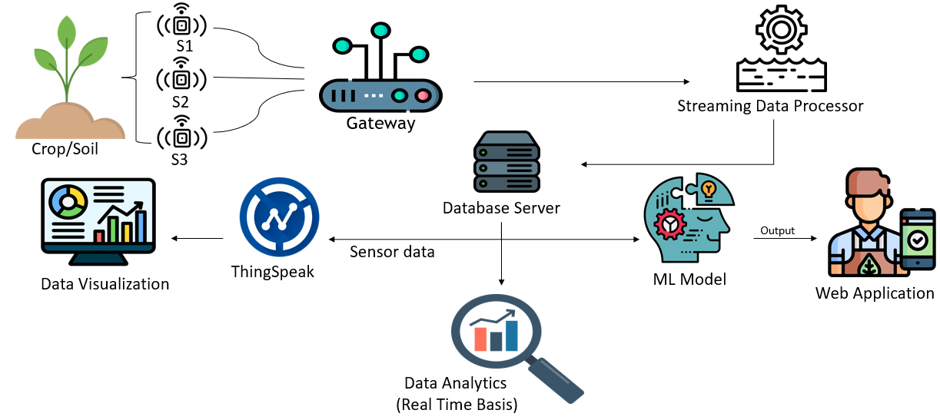
2.1 Proposed System

Slide 16
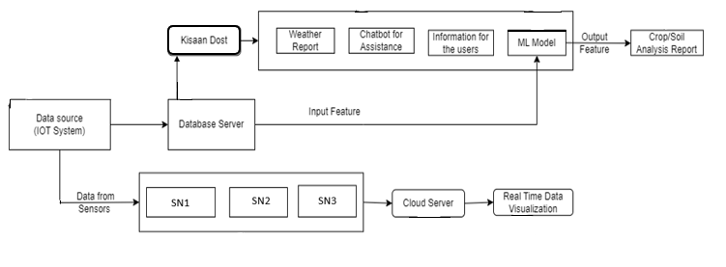
2.2 Design(Flow Of Modules)

Slide 17
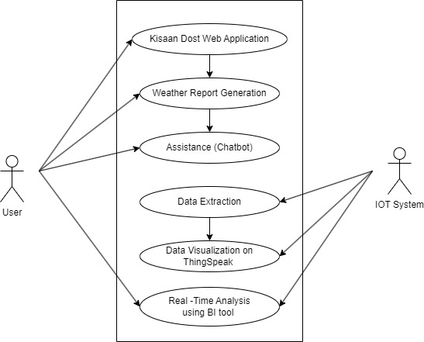
2.3 Use Case

Slide 18
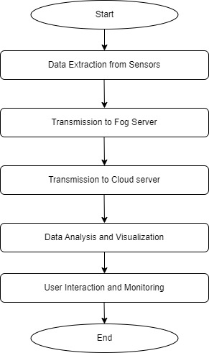
2.4 Activity diagram

Slide 19
3. Implementation

Slide 20
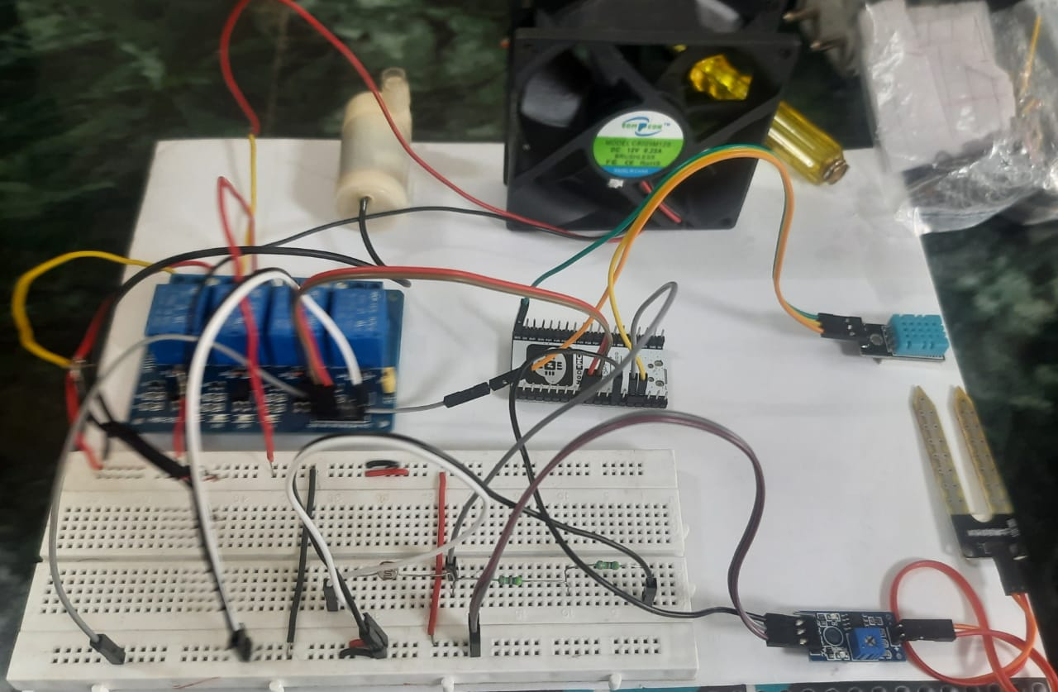
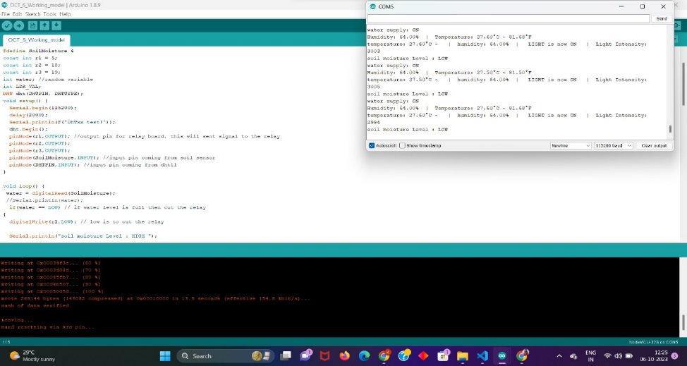
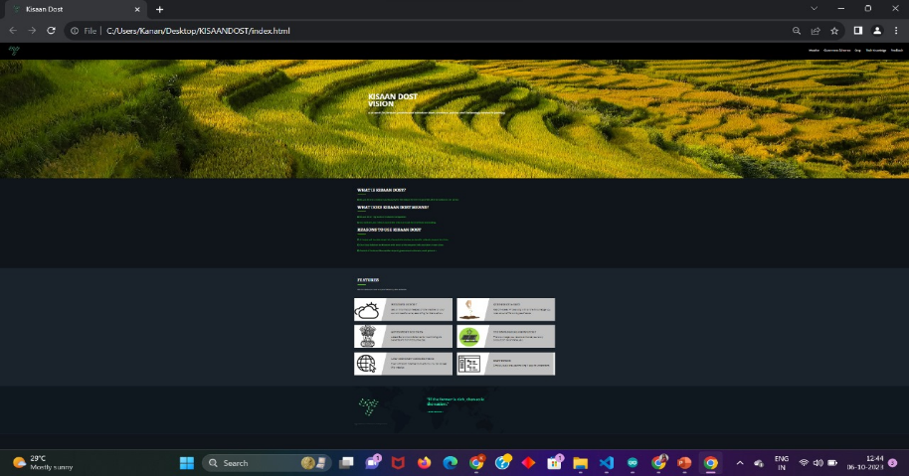
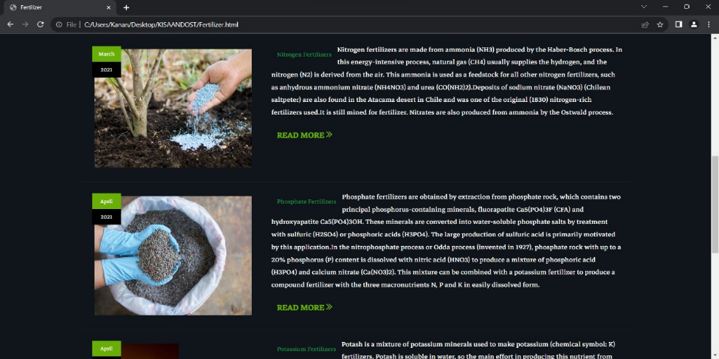

Slide 21
4. Testing

Slide 22
4.1 Test Cases
Test Case No. | Test Case Name | Test Case Feature | Expected Result | Actual Result | Status
1 | Load the Dataset | Checks whether the data selected are loaded or not. | The crop yield data to be loaded from the dataset. | Loaded crop yield dataset which is used for the Processing. | Successful
2 | Pre-Processing Module Testing | Data Labelling | Unwanted attributes Removal | Unwanted data files removed | Successful
3 | Training Module Testing | Training the Crop recommedation dataset | The crop recommendation dataset to be trained | Trained the crop recommendation dataset | Successful

Slide 23
5. Result

Slide 24
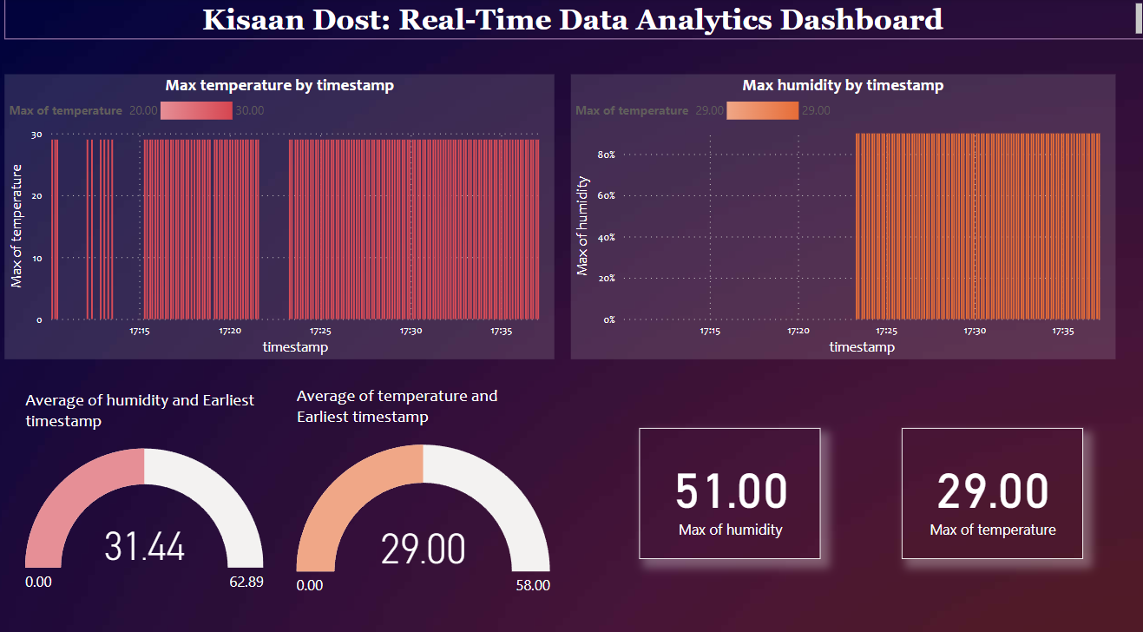

Slide 25
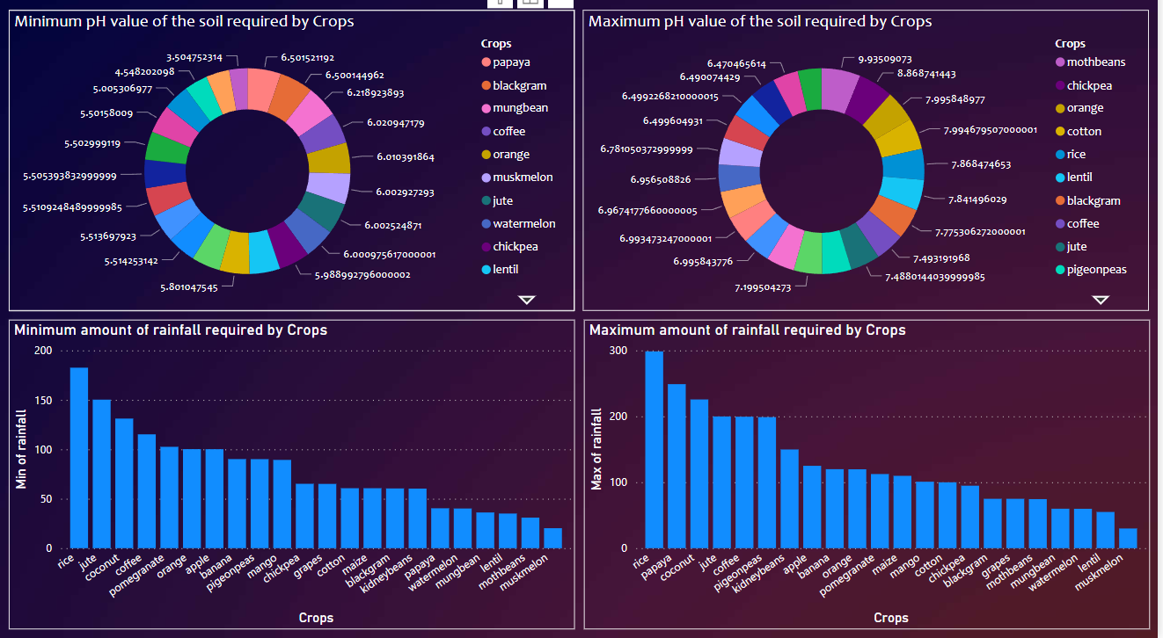

Slide 26
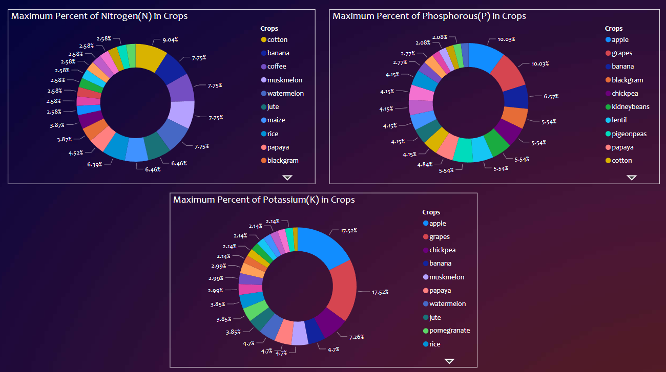

Slide 27
6. Conclusion and Future
Scope

Slide 28
6.1 Conclusion
"Kisaan Dost" utilized ML, IoT, and Deep Learning to optimize farming practices.
It extracted real-time data on soil and field parameters using integrated sensors.
The data was transmitted to fog computing, ThingSpeak Cloud servers, and Power BI for centralized analysis and visualization.
The user-friendly interface allowed farmers to monitor and interpret agricultural parameters, enabling precise resource allocation and optimized fertilization for enhanced crop yields and sustainable soil quality.

Slide 29
6.2 Future Scope
Integration with Agricultural Supply Chain: Connecting the Farming Companion to other elements of the agricultural supply chain. This could involve linking with market data, enabling farmers to make informed decisions not only on cultivation but also on selling their produce.
Enhanced Data Visualization: Evolving the visualizations of crop parameters to include more comprehensive and interactive features. This could involve the integration of 3D modeling or augmented reality to offer a more immersive experience, aiding farmers in better understanding the impact of environmental factors on crop growth.
User Customization: Allowing farmers to customize the system to their specific farming practices and preferences. Providing a user-friendly interface where farmers can set personalized parameters and preferences for their crops.

Slide 30
References
[1] Sampath Swathi Reddy, Kalaga Prashanthi, Vanagapalli Vamshi Krishna, G.Vinesh, Dr. Suwarna Gothane,``Agro Farming using Machine Learning", International Journal for Research in Applied Science & Engineering Technology (IJRASET), 2021
[2] Huang, W., Lu, W., & Chen, H. , ``IOT Based Smart Agriculture Monitoring System", 3rd International Conference on Control Science and Systems Engineering (ICCSSE), (pp. 496-499), 2019
[3] Abhilash Lad, Sumitra Nandre, Krishna Raichurkar, Sumit Zarkhande, Dr. Priya Charles , ``Smart Agriculture Monitoring and Control System Using IOT", Ijraset Journal For Research in Applied Science and Engineering Technology , 2022
[4] R. R. Rubia Gandhi; J Angel Ida Chellam; T. N. Prabhu; C. Kathirvel; M. Sivaramkrishnan; M. Siva Ramkumar, ``Machine Learning Approaches for Smart Agriculture", International Conference on Computing Methodologies and Communication (ICCMC),IEEE , 2022

Slide 31
Patent
Patent has been officially filed for the system proposed titled “Kisaan Dost: A Comprehensive ML and IOT based Web Framework for Smart Agriculture”.

Slide 32
Thank You

